Slide 1



UNIT 2
Lesson 5 Achievements
Part 5

Slide 2
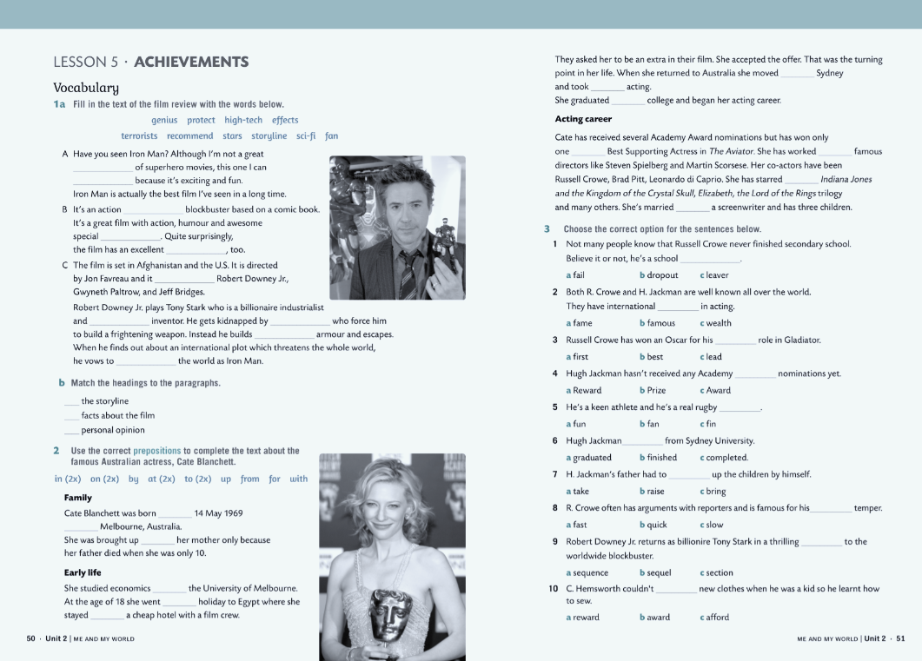
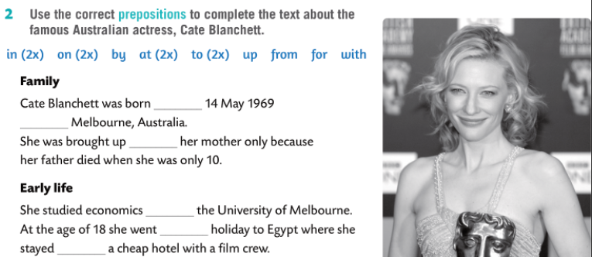
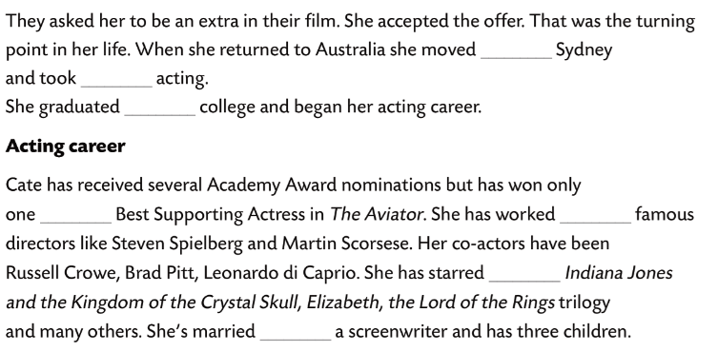
on
in
by
at
on
at
to
up
from
for
with
in
to

Slide 3
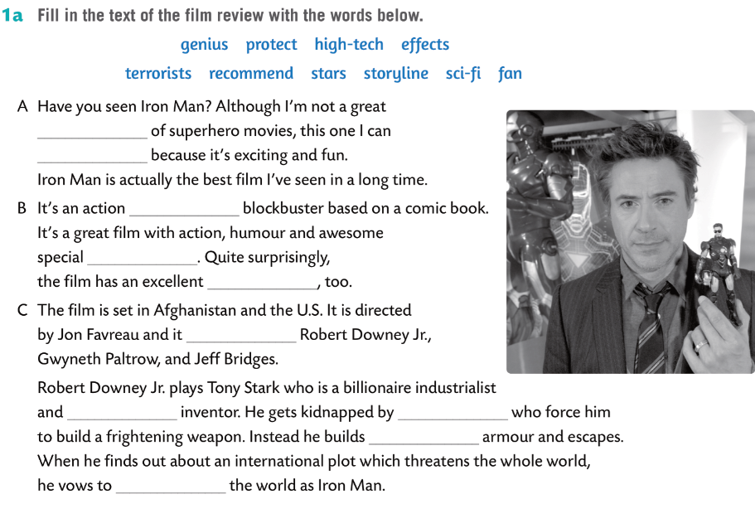
Do a writing activity.
Using the information you have collected, write a biography of that actor/actress.
After you have finished writing your text, read it out.
fan
recommend
sci-fi
effects
storyline
stars
genius
terrorists
high-tech
protect

Slide 4
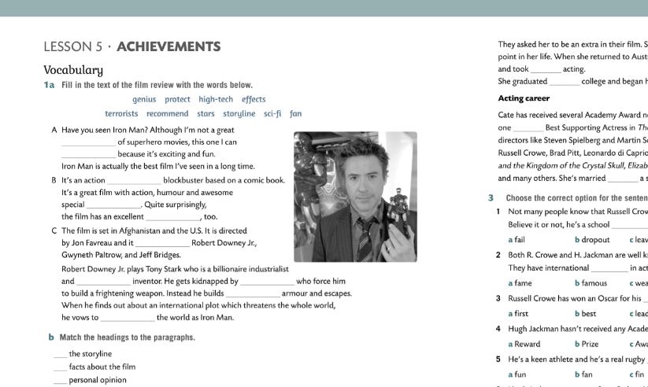
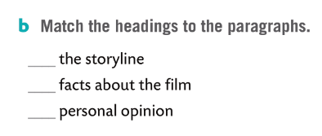
Talk about a film you have recently seen, using the following questions:
What’s the film called?
What sort of film is it?
Who directed it?
Who starred in it?
Who are the main characters?
What is it about?
Why do you like it?
Who could you recommend it to? Why?
C
B
A

